Slide 1
The Three Point Shot
Story of how the use of data
changed the sport of basketball, told through analysis of
the last 45 years of the world’s most prestigious basketball league -
NBA.
Made by:
Antonio Đurica

Slide 2







1
Tools and data origin
Software
Data source

Slide 3
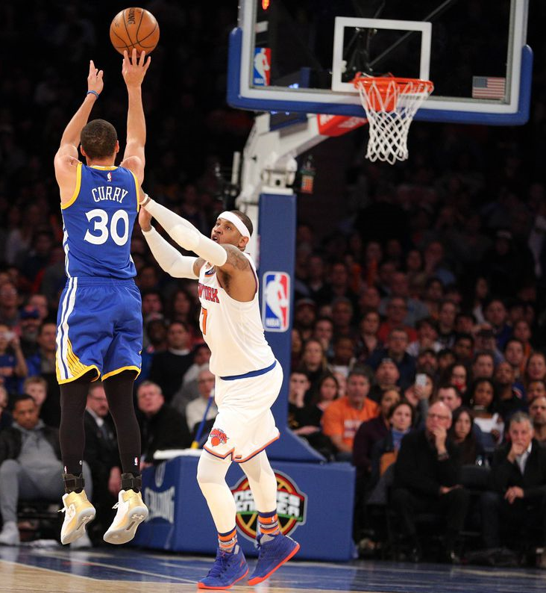
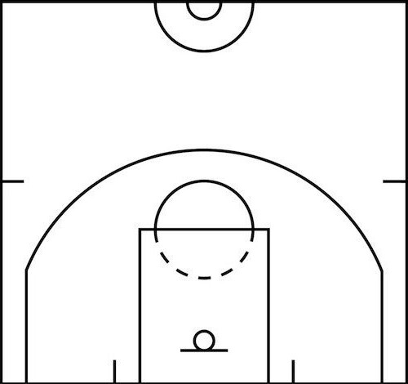
2
The Three Point Line

Slide 4
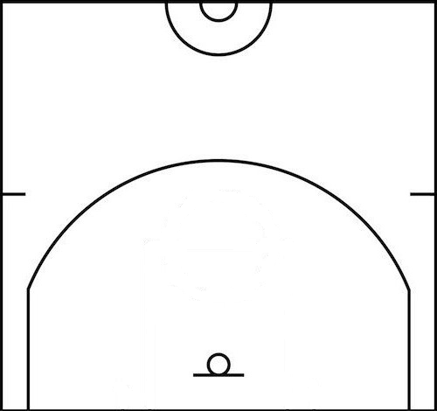
2
The Three Point Line
23.75ft (7.24m)
22 ft (6.7m)

Slide 5
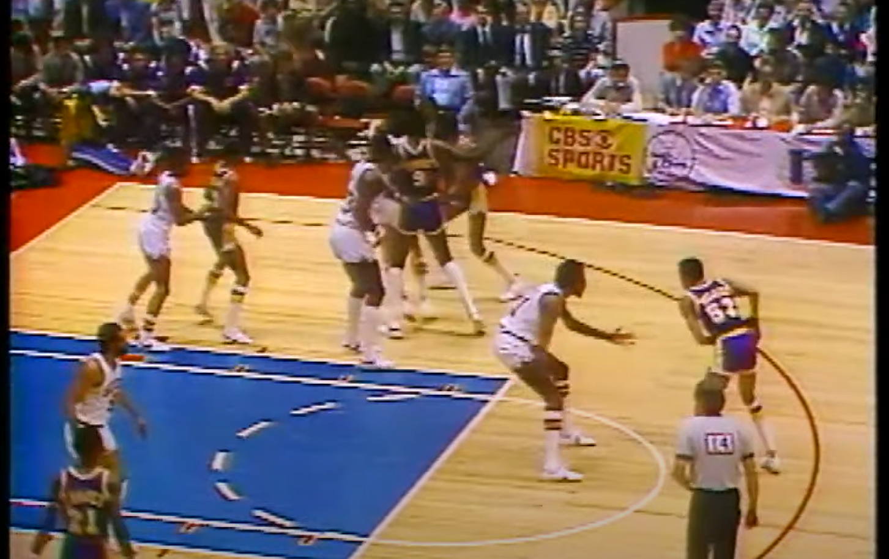
3
How it once was
1980 NBA Finals
Distinct neglect of the three point line in positioning

Slide 6
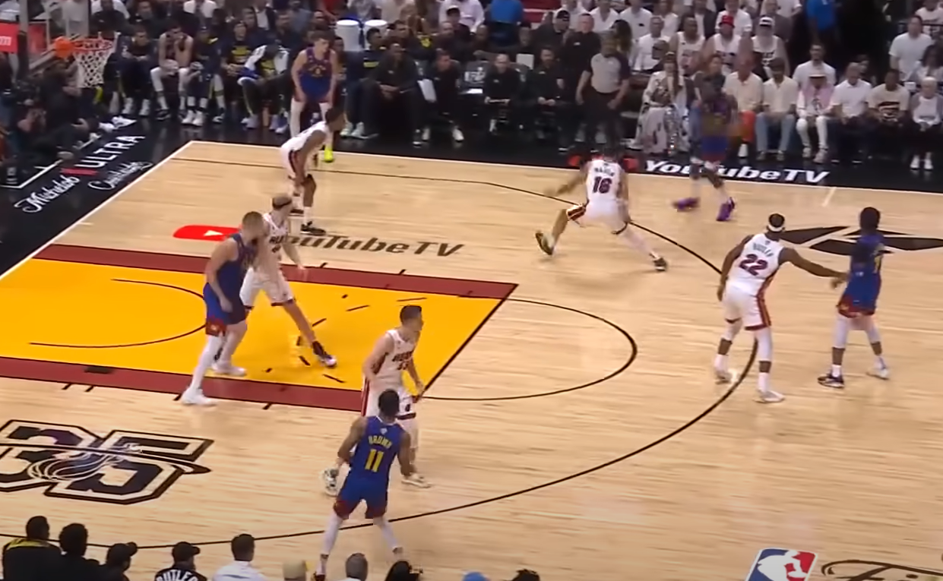
How it is today
4
2023 NBA Finals
Influence of the three point line in full display

Slide 7
5
The magnitude of change
1980 NBA Finals
2023 NBA Finals

Slide 8
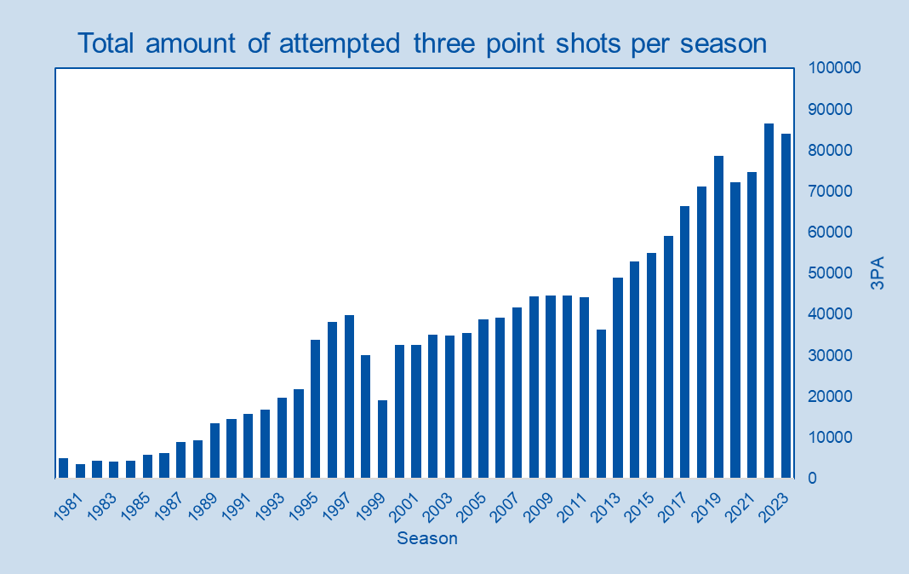
6
The Rise
Key Points

Slide 9
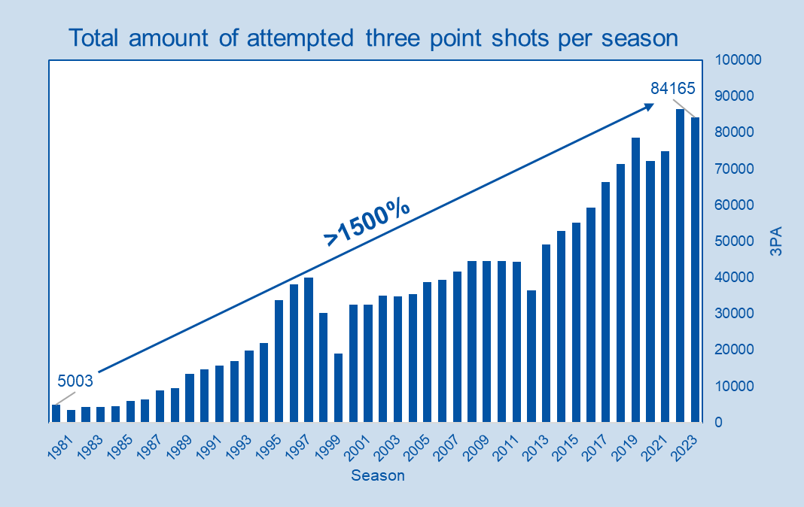
6
The Rise
Key Points
Increase of >1500%

Slide 10
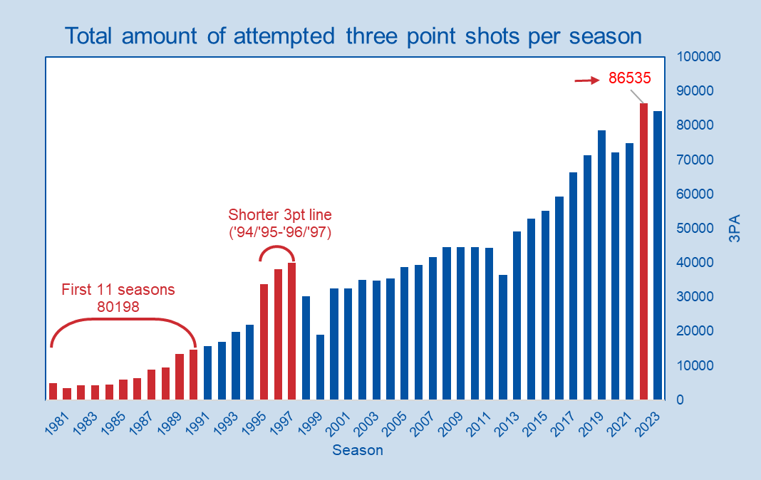
6
The Rise
Key Points
Increase of >1500%
Peak ‘21/’22
Peak in ‘21/’22 – 86535
More then first 11 season
combined - 80198
Short-term increase
From ‘94 to ‘97 due to shorter 3pt line

Slide 11
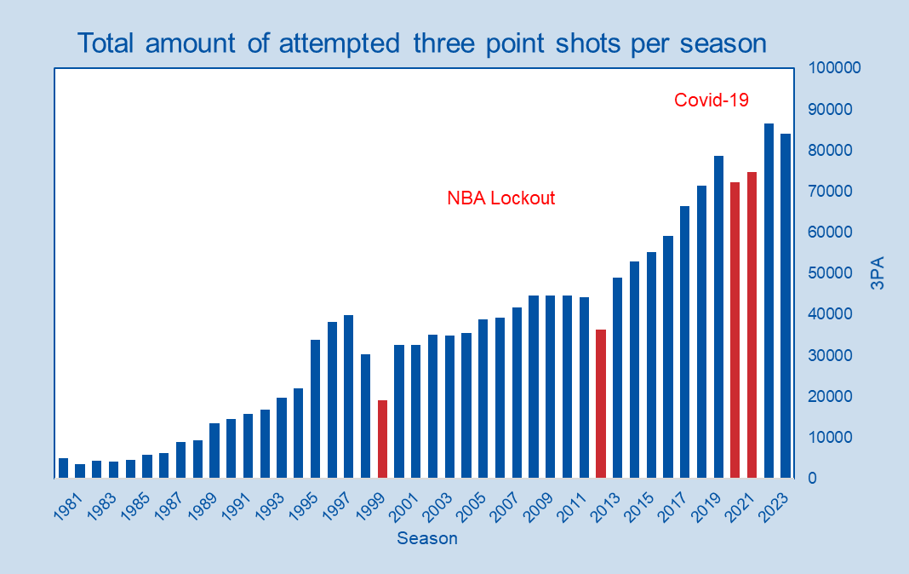
6
The Rise
Key Points
Increase of >1500%
Peak in ‘21/’22 – 86535
More then first 11 season
combined - 80198
Short-term increase
from ‘94 to ‘97 due to shorter 3pt line
Occasional drop-off
due to external
impact

Slide 12
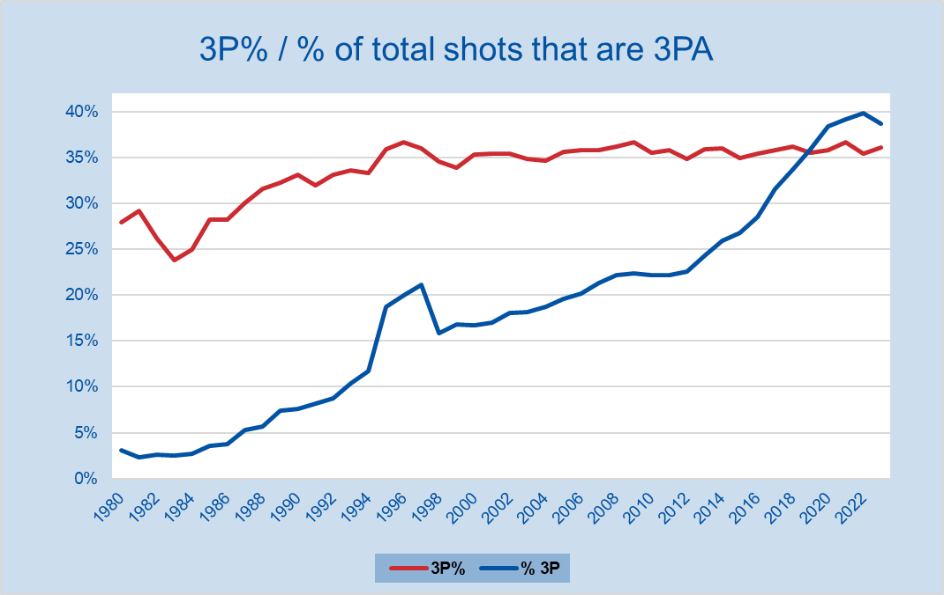
7
More shots - less acuracy?
Key Points
Percentage of shots that are 3 pointers increases
dramatically
Despite the increase
accuracy does not vary
much
From ‘90s on it
fluctuates at just
above 35%

Slide 13
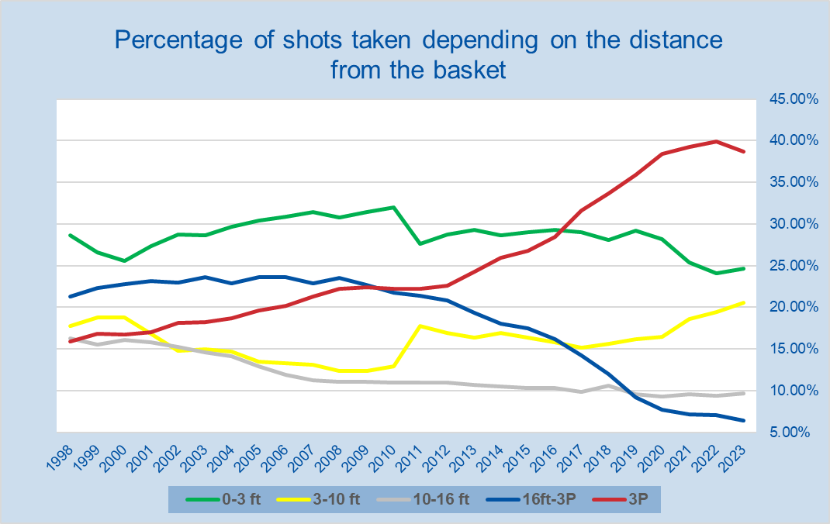
8
More 3’s – less Mid-range shots
Key Points
3P rise from 15% to
almost 40%
16 ft – 3P decrease to as little as 6%
Correlation between
3P rise and 16ft-3P fall
Crossover point in 2009

Slide 14
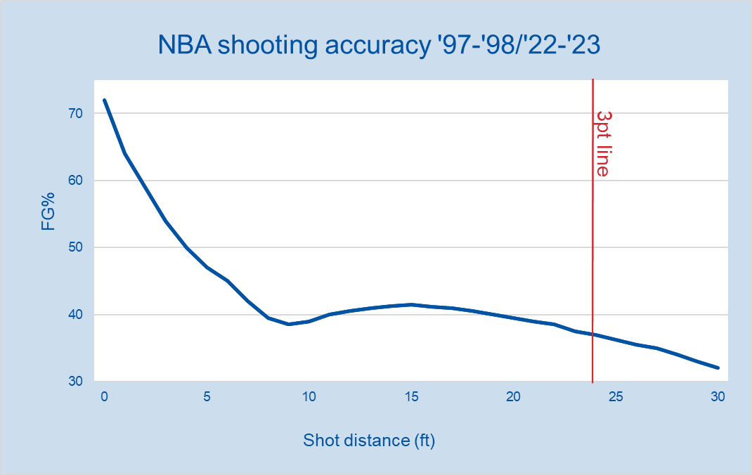
9
The closer the better
Key Points
FG% - Percetage of shots taken that are made
Shot distance data avaliable only
from 1997
Gradual decrease with increased distance
Slight departure from
the trend around 15ft

Slide 15
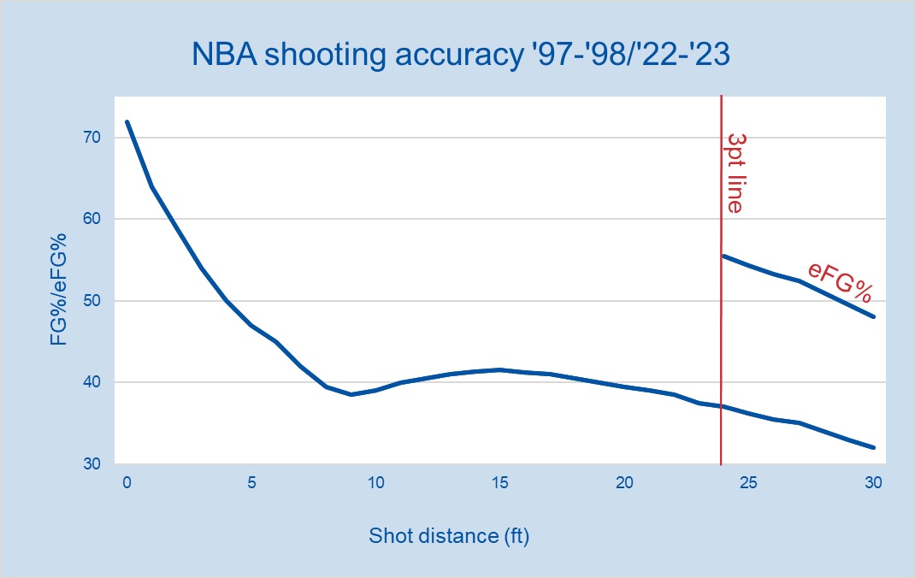
9
Or is it?
Key Points
eFG% - takes into
account extra value
of a 3pt shot
When adjusted 3pt shot
looks a lot more valuable
Only shot taken from
closer then 3ft are
more desirable

Slide 16
Introducing new metrics
10
Winning Percentage
(Win%)
-Percentage of games played in a season
that a specific team won
Points Per Game
(PTS/G)
-Average amount of points that a team or an
Indvidual score in a game
Offensive Rating
(Ortg)
-Estimate of points scored by team
adjusted for the pace of the game

Slide 17
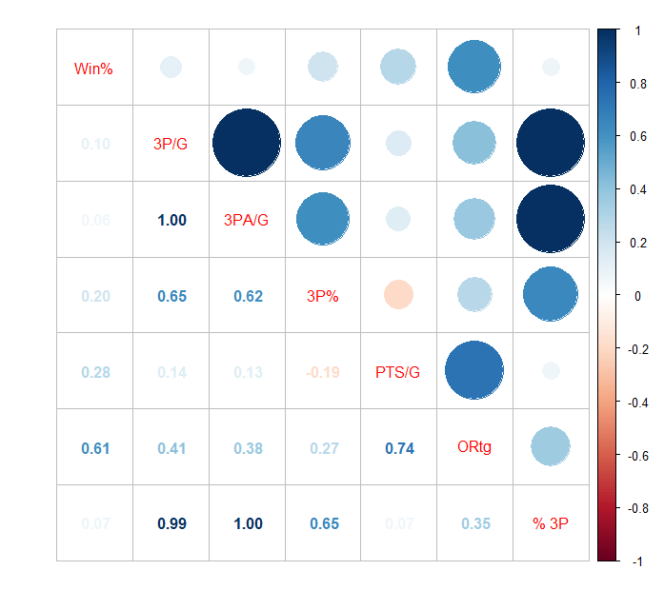
3 point shot - correlation
11
How connected is three point shooting with
Winning
Scoring
Team Offence
Data -1979/2023

Slide 18
3 point shot - correlation
11
Data -1979/2023
Winning percentage lacks correlation with three point shooting

Slide 19
3 point shot - correlation
11
Data -1979/2023
Winning percentage lacks correlation with three point shooting
Scoring (PTS/G) has slightly stronger
correlation

Slide 20
3 point shot - correlation
11
Data -1979/2023
Winning percentage lacks correlation with three point shooting
Scoring (PTS/G) has slightly stronger
correlation
While Ortg has the strongest relationship with 3pt shooting

Slide 21
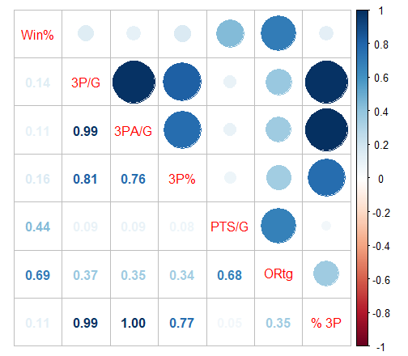
12
1979-1990
1980s | Win% | PTS/G | Ortg
3P/G | 0.14 | 0.09 | 0.37
3PA/G | 0.11 | 0.09 | 0.35
3P% | 0.16 | 0.08 | 0.34
% 3P | 0.11 | 0.05 | 0.35

Slide 22
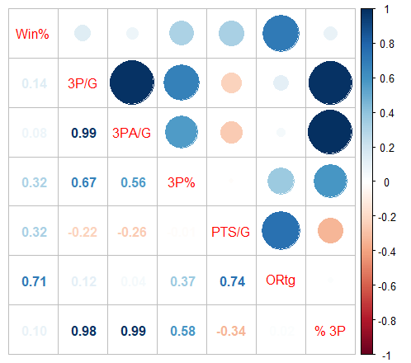
13
1991-2000
1990s | Win% | PTS/G | Ortg
3P/G | 0.14 | -0.22 | 0.12
3PA/G | 0.08 | -0.26 | 0.04
3P% | 0.32 | 0.04 | 0.37
% 3P | 0.10 | -0.34 | 0.02

Slide 23
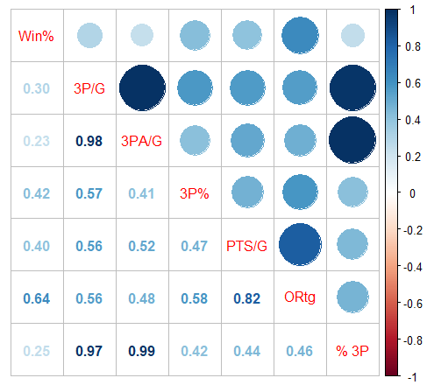
14
2001-2010
2000s | Win% | PTS/G | Ortg
3P/G | 0.30 | 0.56 | 0.56
3PA/G | 0.23 | 0.52 | 0.48
3P% | 0.42 | 0.47 | 0.58
% 3P | 0.25 | 0.44 | 0.46

Slide 24
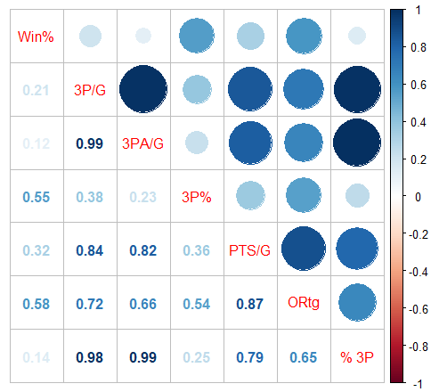
15
2011-2023
2010s | Win% | PTS/G | Ortg
3P/G | 0.21 | 0.84 | 0.72
3PA/G | 0.12 | 0.82 | 0.66
3P% | 0.55 | 0.36 | 0.54
% 3P | 0.14 | 0.79 | 0.65

Slide 25
16
Correlation Coefficient Table
 | Winning percentage |  |  |  | Points Per Game |  |  |  | Offensive Rating
 | 1980 | 1990 | 2000 | 2010 | 1980 | 1990 | 2000 | 2010 | 1980 | 1990 | 2000 | 2010
3P/G | 0.14 | 0.14 | 0.30 | 0.21 | 0.09 | -0.22 | 0.56 | 0.84 | 0.37 | 0.12 | 0.56 | 0.72
3PA/G | 0.11 | 0.08 | 0.23 | 0.12 | 0.09 | -0.26 | 0.52 | 0.82 | 0.35 | 0.04 | 0.48 | 0.66
3P% | 0.16 | 0.32 | 0.42 | 0.55 | 0.08 | 0.04 | 0.47 | 0.36 | 0.34 | 0.37 | 0.58 | 0.54
% 3P | 0.11 | 0.10 | 0.25 | 0.14 | 0.05 | -0.34 | 0.44 | 0.79 | 0.35 | 0.02 | 0.46 | 0.65

Slide 26
17
Linear Regression Models (2011-2023)
2010s | Win% | PTS/G | Ortg
3P/G | 0.21 | 0.84 | 0.72
3PA/G | 0.12 | 0.82 | 0.66
3P% | 0.55 | 0.36 | 0.54
% 3P | 0.14 | 0.79 | 0.65
Model1 = Win% - 3P%
Model2 = PTS/G - % 3P
Model3 = ORtg – 3P/G

Slide 27
18
Models - results
Model1 = Win% ~ 3P%
Model2 = PTS/G ~ % 3P
Model3 = ORtg ~ 3P/G
Correlation = 0.55
Coefficients: Intercept = -1.1473
3P% = 4.6206
P-Value = <2e-16 ***
R-squared = 0.3076 – 30.76%
Model P-Value = <2.2e-16
Correlation = 0.79
Coefficients: Intercept = 82.8632
% 3P = 71.7479
P-Value = <2e-16 ***
R-squared = 0.6178 – 61.78%
Model P-Value = <2.2e-16
Correlation = 0.72
Coefficients: Intercept = 97.8008
3P/G = 1.1365
P-Value = <2e-16 ***
R-squared = 0.5163 – 51.63%
Model P-Value = <2.2e-16
All models suggest statistically
significant and postive relationship between variables

Slide 28
Thank You for your Attention
Questions?

